Slide 1
DHI‘s Data and Sensor strategy Data Acquisition, Management, Decision Support and Operations
Dr. Ole Larsen, DHI

Slide 2
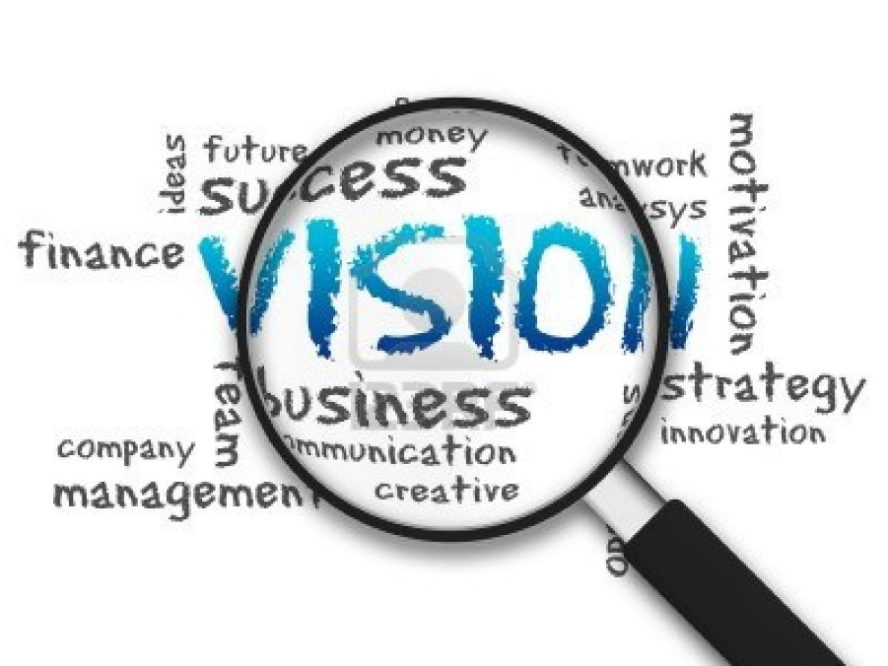
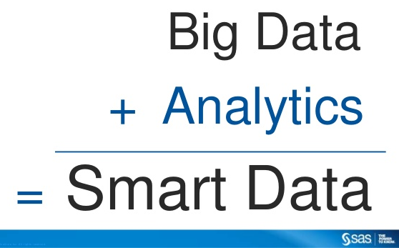
Data & Sensors
Increasingly mobile society
Imminent need for instant access to data and information
Public awareness
Consumer accessibility to technology
Better forecasts
Active lifestyles
Population growth
Continued miniaturization
Data sharing
Smaller – cheaper - smarter
New digital sensors
Crowd sourcing
Data sharing and analytics

Slide 3
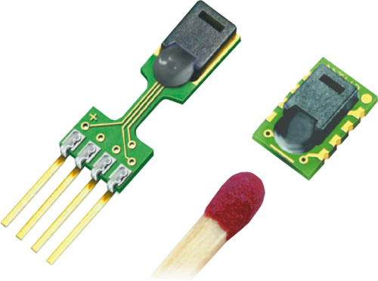
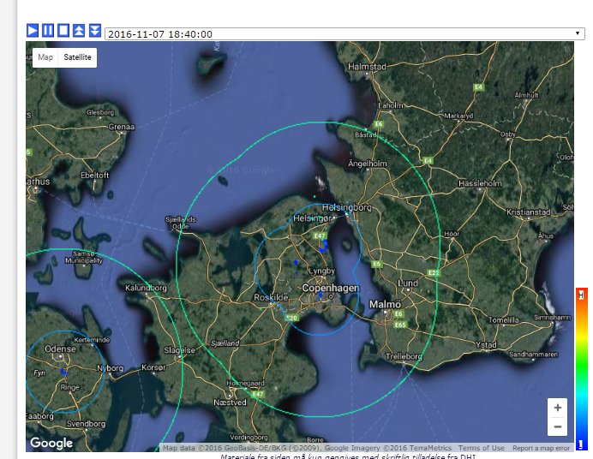
DHI’s sensor products
New hardware based on digital sensors
New digital data acquisition “modem”
Business arrangements with “classical” hardware producers
Using radar for flash flood and storm water management

Slide 4
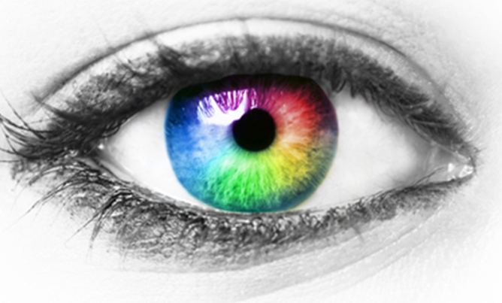
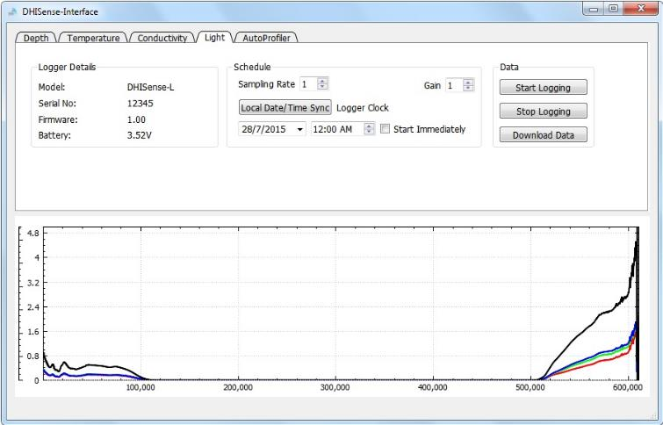
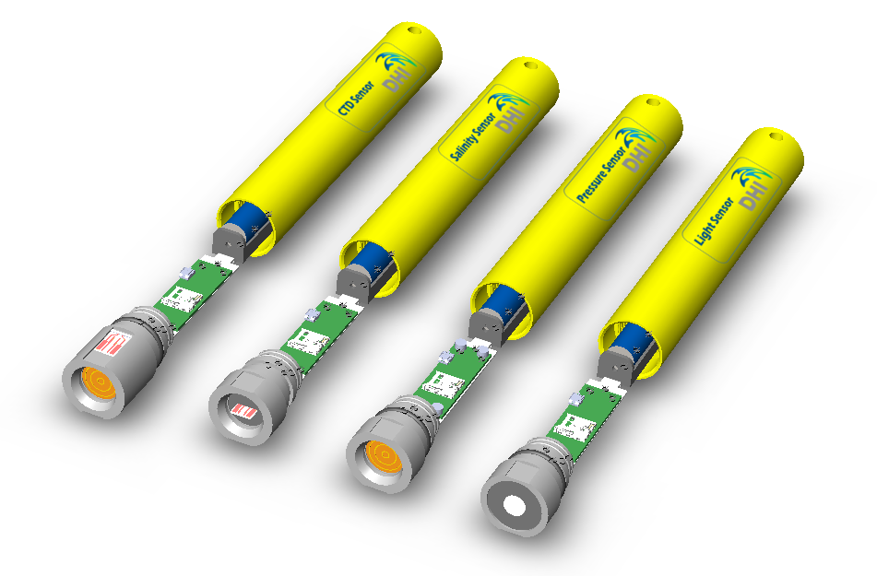
DHI Sense / DH
One Software
One Hardware Platform

Slide 5
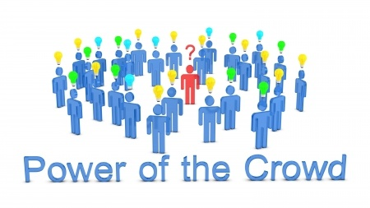
Using human as sensor
Apps for crowdsourcing water & environment data
General app that make use of sensors built in smartphones
Making use of “privately owned sensors”
Platform to share data from academia
Data “back-end” to receive, share and analyse data

Slide 6
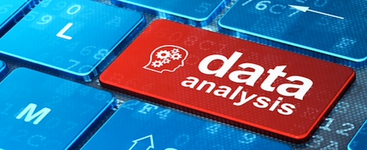
Making use of Data
Optimized data storage, handling and web-front ends as well as associated analysis layer
DataFarm
DHI Water Data Portal
Coupling to external analysis tools (eg. R and PhreeqC)
Providing data to cloud hosted models
Managing model data

Slide 7
Summary
New smart digital sensors
Using Radar for rainfall measurements
Lots of equipment out there – we integrate it - from sensor to DSS
Crowdsourcing technology
DataFarm and other data services
Cloudbased computing (data management and modelling)
Web and apps for efficient tailored dissemination of results
Collaboration…

Slide 8
Thank you for your attention!
Dr. Ole Larsen, DHI

